Slide 1
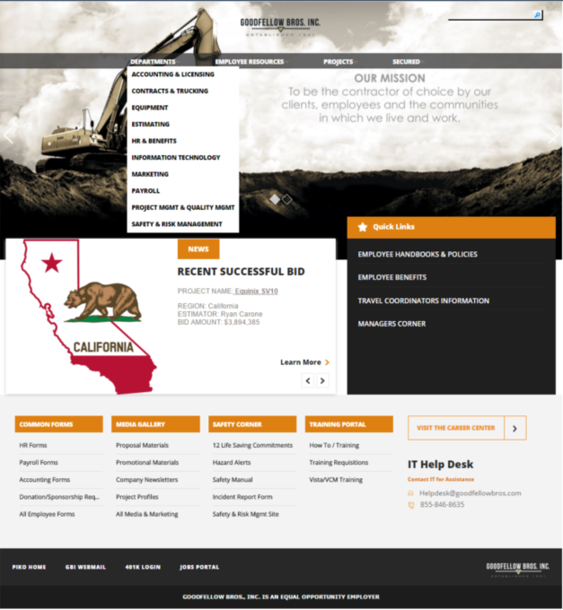
Goodfellow Bros Construction – SharePoint Intranet
Business Need
Good fellow Bros. Inc. came to Affirma after having a year long unfavorable experience with another SharePoint consultant. The client had an aggressive deadline to deploy and go live. Adoption was a critical success factor. They needed a partner to engage quickly while creating a long-term relationship with a well-established SharePoint consultancy.
Results
Utilizing best practices, we designed and implemented the new site. The site is now in production with a great user experience and high adoption. Our team continues to work with them to identify opportunity for long tern growth in their SharePoint environment.

